Slide 1
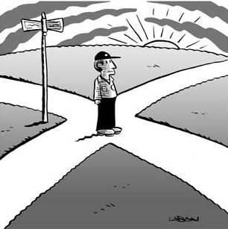
If you want to go somewhere that you have never visited before, how do you find your way?

Slide 2
How do animals navigate then?

Slide 3


sun
moon
stars

Slide 4
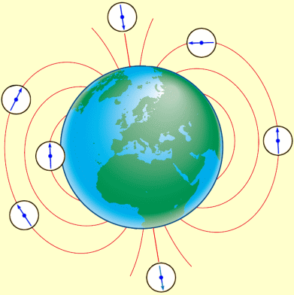

magnetic fields

Slide 5
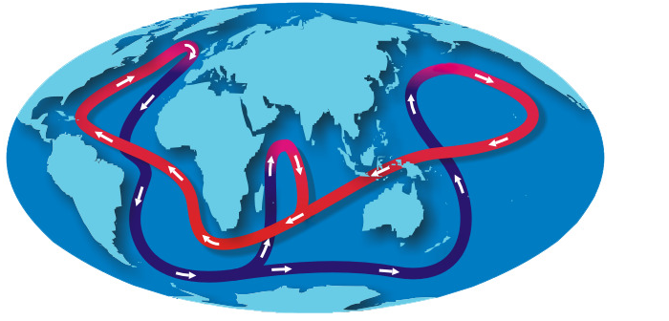
ocean currents

Slide 6
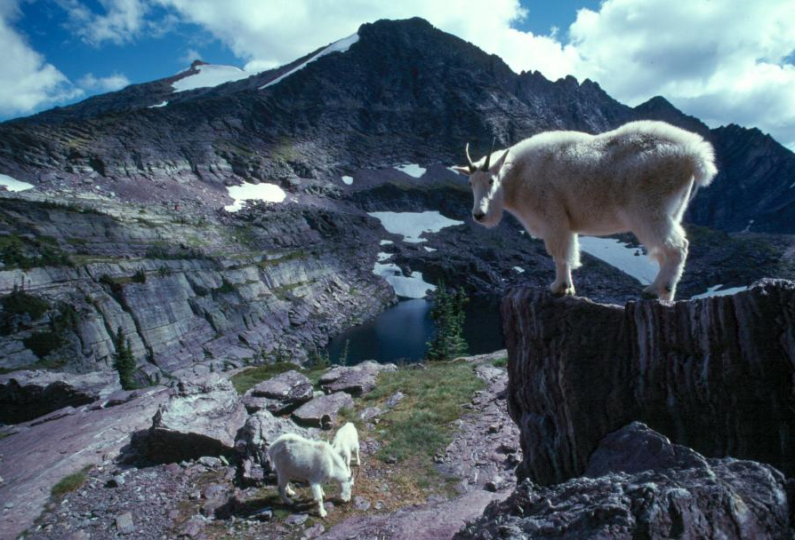
mental maps
(landscapes and landmarks)

Slide 7
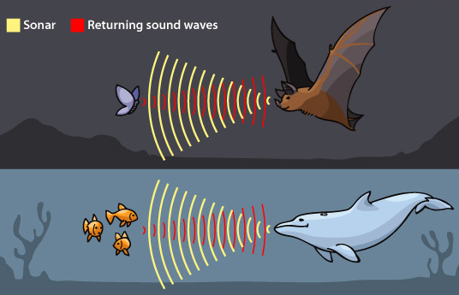
echolocation
(sounds)

Slide 8

?

Slide 9
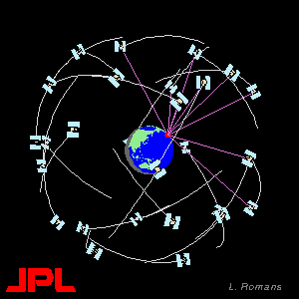
GPS

Slide 10
What is GPS ?
Global
Positioning
System
What is a satellite navigation system?
(Sat-Nav)

Slide 11
Examples of Sat-Nav Systems
USA: GPS
Russia: GLONASS
EU: Galileo

Slide 12
Translate into English:
English | Slovene
global | globalen
position | pozicija
system | sistem
GPS | GPS
satellite | satelit
navigation | navigacija

Slide 13
Translate into English:
English | Slovene
transmitter transmit | transmiter oddajati
radio | radio
operational | operativen
monitor | monitor
signal | signal
information | informacija
calculate | kalkulirati

Slide 14
Loan Words
Notes:
Hamburger, pizza, comp (computer),

Slide 15
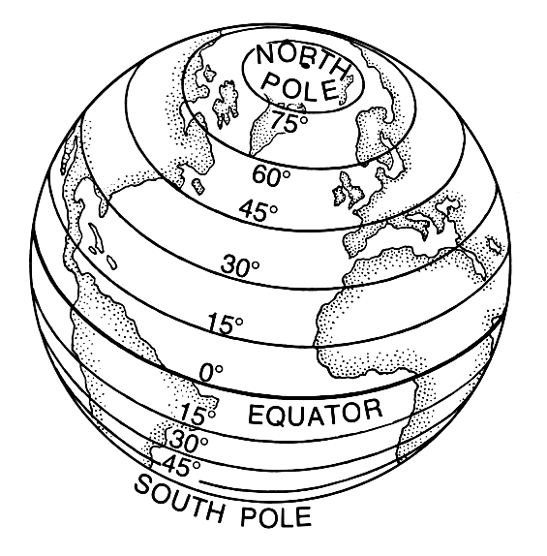
Latitude

Slide 16
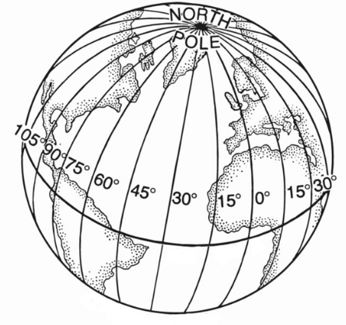
Longitude

Slide 17
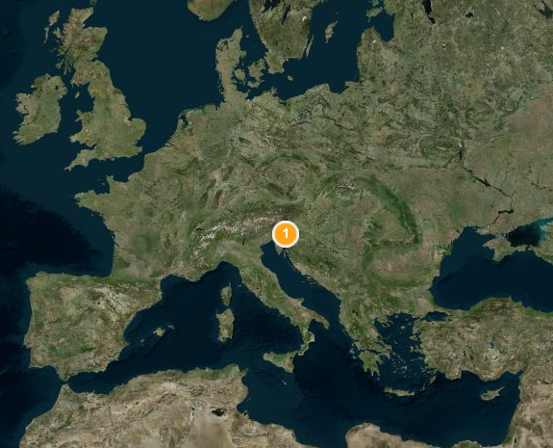

Coordinates of SŠTS Šiška
Longitude
14.49° E
Latitude
46.08° N

Slide 18
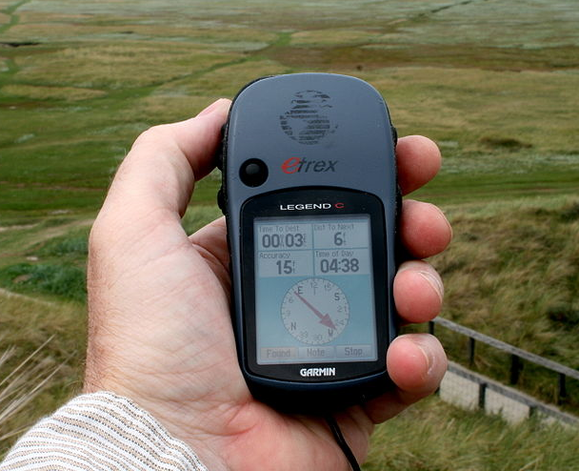
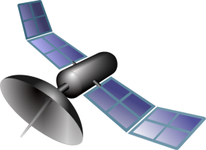
How GPS Works
You’ll need:
A GPS receiver
At least 3 known positions (GPS satellites)

Slide 19
Where am I ?
Trilateration in 2D

Slide 20
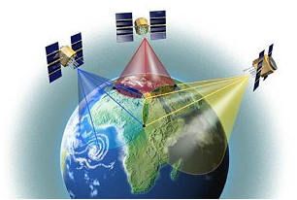
Trilateration in 3D
Notes:
http://blogs.kqed.org/newsfix/2012/08/22/4-tips-for-recovering-your-stolen-phone-or-tablet/

Slide 21
Answer the questions:
What kind of services does GPS provide?
Positioning and timing services

Slide 22
Answer the questions:
(2) Who developed GPS?
The U.S. military

Slide 23
Answer the questions:
(3) What does a user need in order to use GPS technology?
A GPS receiver

Slide 24
Answer the questions:
(4) Name one situation where GPS can be used to save lives.
preventing transportation accidents /
search and rescue /
emergency services

Slide 25
Answer the questions:
(5) How was GPS technology useful when installing the solar tracker at our school?
It was used to determine the tracker’s exact location.

